Slide 1
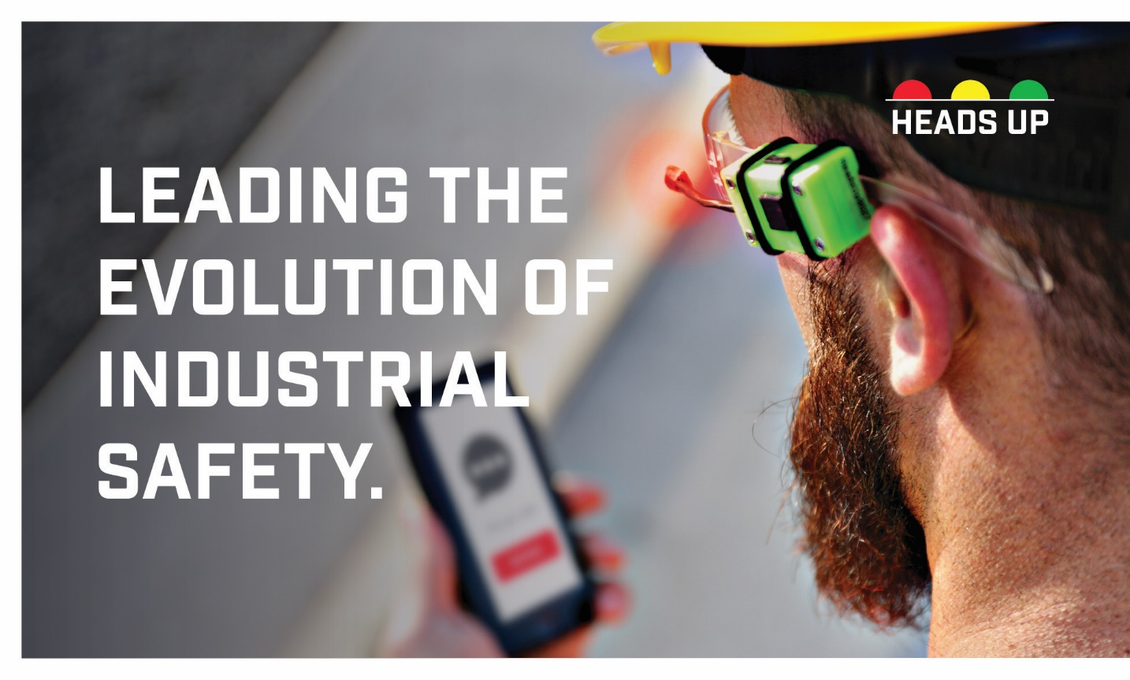

Slide 2

EXPLAINER VIDEO
Notes:
Here is a video that concisely summarizes the communication systems current capabilities.
Play.

Slide 3
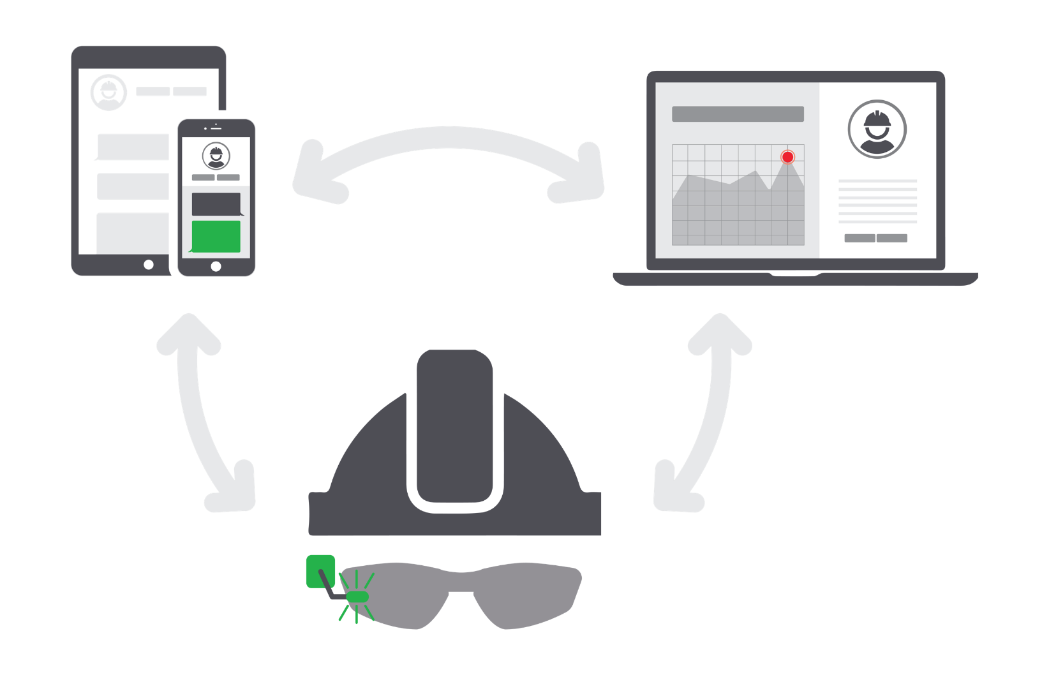
HEADS UP PLATFORM
MOBILE APP
DASHBOARD
INDICATOR
Notes:
So, to recap.
The devices is a set of indicator LED’s that can accessorize any head worn protection,
Attach with o rings to your safety frames, or double sided Velcro to a face shield for example.
The device connect to a mobile application.
On the mobile application, operators can communicate with each other using messages, just like text.
I send you a message mobile to mobile, that triggers a Bluetooth signal to your heads up.
The indicator device has sensors that transmit over Bluetooth to the Heads Up mobile application.
There you can read the current exposure levels in your work environment.
From there, it connects to your administrative website
There safety managers can monitor the hazards in their crews environment, and ensure they all have the equipment necessary to
Get you home to their families.
In short, we are the first industrial Fitbit

Slide 4
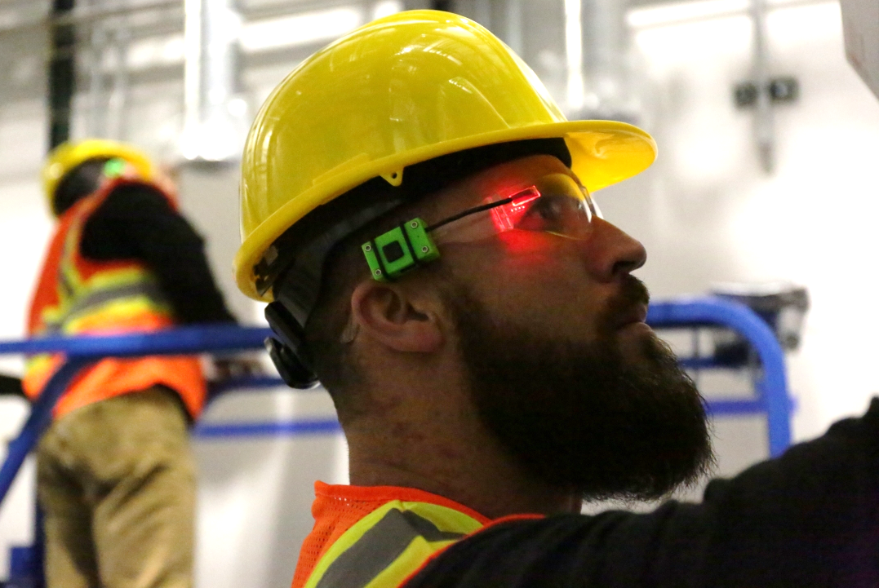


CURRENT FUNCTIONALITY
Simple, Effective, Communication.
Notes:
The Device is a platform, but over the last 3.5 years we have interviewed over
100’s of companies to determine the functionality of our 1st release.
Training is simple:
Red: there is an urgent message or call in the HU mobile app regarding safety.
Blue: there is a message or call incoming concerning site coordination.
Green: the noise indicator has detected you should be wearing ear protection.
Its that simple.

Slide 5

EMERGENCY NOTIFICATIONS
Emergencies
Man Down (EMT)
Evacuations
Stand downs
Training
Communicating Safety, Safely.
Notes:
Here is an example of the demonstration videos you will have access to in order to educate our clients.
This is how the system is used to indicate that there is a message regarding safety to an operator.
We train our operators to safely stop work, conduct a (Stop, Look, Listen)
to make sure they are in a safe position to use their mobile devices.
and check their phone for a message regarding site safety.
Play Demo Video
Demonstrate Live.
Ok Everyone Glasses on.
This is a huge problem for early to middle stage construction sites,
demolition organizations, remote workers, surface miners, to name a few.
We have used this at the Riverbend construction site for the past 9 months, and it has performed well.
This technology represents a massive advancement over the use of airohorn evacuation.

Slide 6
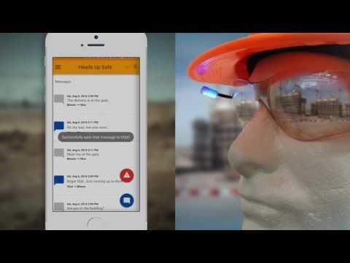
TWO WAY COMMUNICATION
Mobil Differentiation
Trailer to field
Spotter to lift
Detailers to Installers
Scheduling
Notes:
The mobile app is capable of sending notifications of two color coded notifications.
What we are doing here is differentiating the communications coming from onsite from that of
facebook, twitter, your wife, kids, etc…
When operators see blue light notifications, they are trained to finish the task at hand,
perform stop look and listen,
and then check the Heads Up mobile app for communication from one of their colleagues,
or managers regarding onsite coordination.
We also train operators to use their mobile phone with their Heads Up…
it may appear silly, but that is only because we have all become numb to this look.
(drop head).
The use of mobile communication onsite has been widely adopted but is being misused.
Studies have shown %85 of all construction site communications are happening on mobile.
It’s estimate that the average person checks their mobile device 55-85 times per day…
we need to take that productivity back by enabling the operators to know when it’s safe to
maintain focus and when their mobile device can be used as a tool, and not a distraction.

Slide 7
ESTIMATED PRODUCTIVITY GAINS
# of Employees @ $30 Hr. | 100
Annual Productivity Savings @ 20 Min/Day | $205,000
Cost of Heads Up | $24,000
Savings | $181,000
Notes:
Often when In construction communication is very challenging, it takes 2 to 3 calls, or texts, and or eventually someone has to go find them some else on the jobsite.
Over the last 6 month of our testing we have been able to estimate that use of heads up is saving operators a minimum of 15min per day.
In and industry where the only profit is markup on labor, we have created serious value.

Slide 8
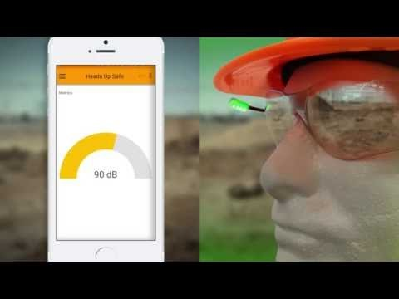
HAZARDOUS NOISE INDICATION
Increase awareness
Real time notifications
Aggregate exposure
Reduced Insurance
Notes:
Ralph
There are sensors packed into this device, we’ve used a microphone,
that is programmed to act as a hazardous noise indicator.
Operators are trained to know that when they see a green light notification,
they are currently in an acoustically hazardous area, and should apply their hearing protection.
They are also able to view how loud the current condition is in real time on their mobile application.
Have a look.
Play Video.
It is a very cool experience to walk around the jobsite and be able to visually see where the hazardous areas are.

Slide 9
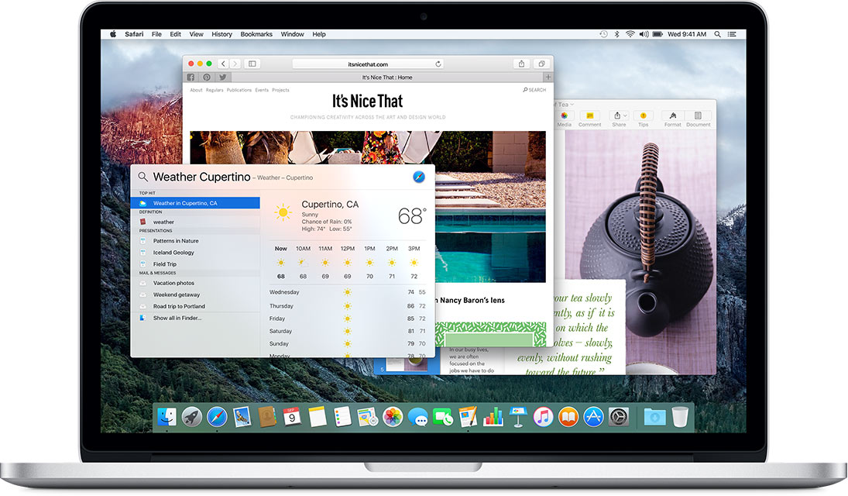
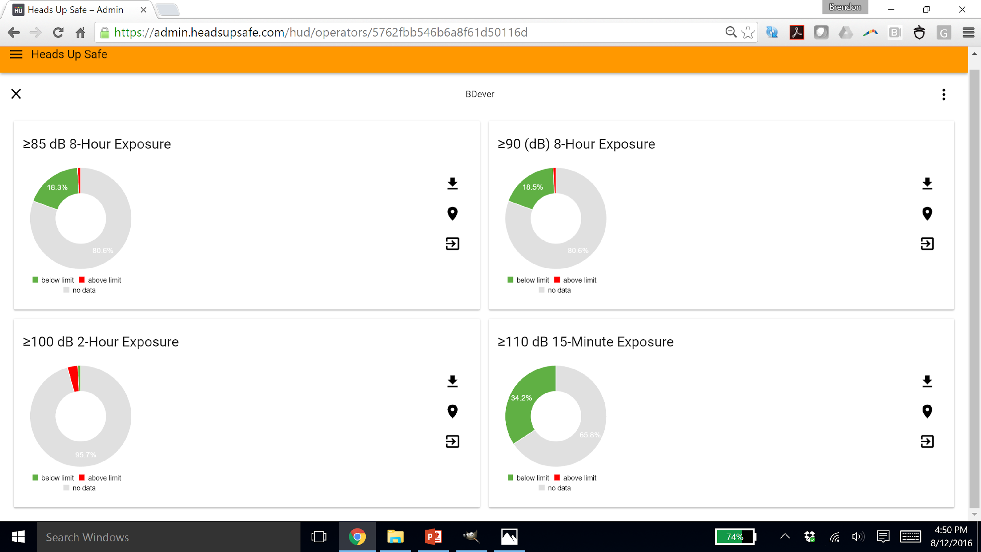
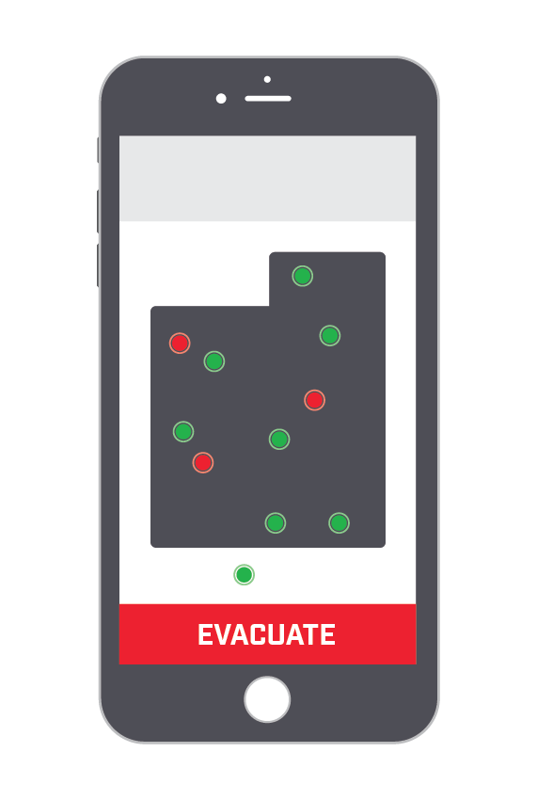
HEADS UP DASHBOARD
REAL TIME HAZARD ANALYTICS
GPS JOBSITES
OSHA/NIOSH COMPLIANCE
ENHANCES SAFETY
INCREASES PRODUCTIVITY
COMPETITIVE ADVANTAGE
REDUCES INSURANCE
admin.headsupsafe.com
Notes:
So what we are really selling is Analytics service.
The system has long term value, the longer the company is on it,
the more information they will get about their crew, their exposure, how to make them safer and more efficient.
Our administrative dashboards provides a real time overview of hazards on the jobsite.
Check it out:
GPS DiVal Site, HERE we are
Individial exposure in real time.
NIOSH & OSHA compliant data review.
Can be used to reduce insurance.
This information will help you sell more product.
If an operator is over exposed, we will direct them to their own DiVal account
where they can buy the appropriately rated hearing protection.
Back to Brendon to explain the business case.

Slide 10

NYS DOL INSURANCE REDUCTION
Employees @ $30 Hr. | 100
Insurance Premium Reduction | $50,490
Annual Cost of Heads Up | $24,000
Savings | $26,490
NYS DOL Code Rule 60.
Notes:
Our Go to Market begins in NYS
In partnership with NYS Dept. of Labor we have determined that Heads Up data
deems companies eligible for incentive programs that will offset the cost of our system
by reducing workman's compensation premiums.
The system can pay for itself +
So that should help us sell. Right?

Slide 11
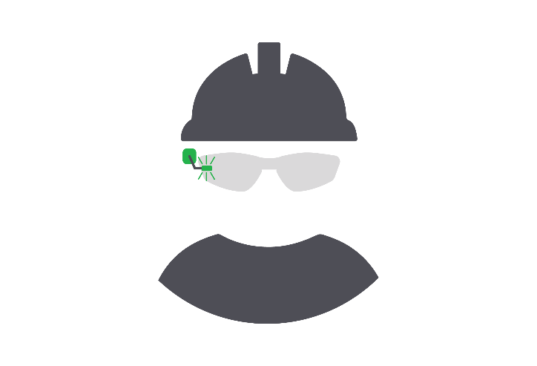
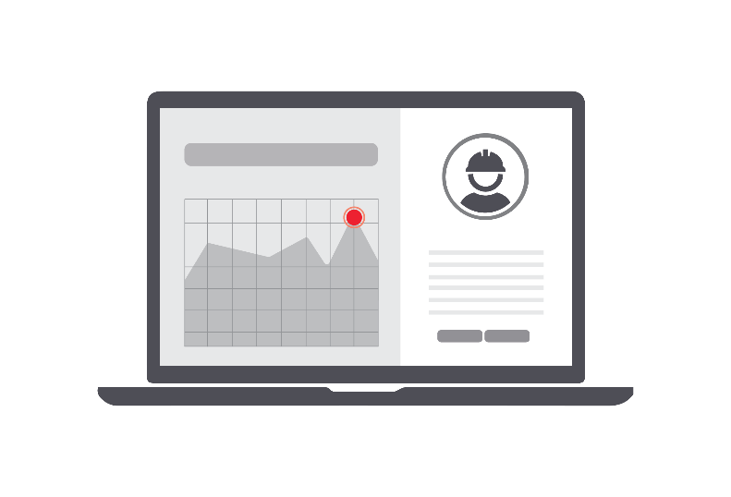





HEADS UP MARKETPLACE
Sensor Data
Analytics
Custom Recommendations
Automatic Insurance Reporting
Premium Reduction
Increased Profit
Notes:
Ok, so here is the The Big IDEA.
First of its kind Individual Sensor Data
Real time analytics
Custom recommendations for PPE & Training
Record Transactional history in regulatory format, saving time
Provide that to insurance providers to receive a reductions in costly insurance premiums
This will positively impact the bottom line of your company in year 1

Slide 12
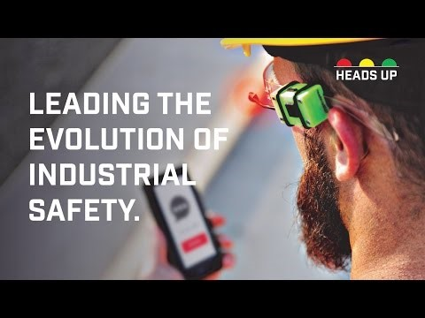
HEADS UP SAFE @ SolarCity Riverbend
Evacuation Procedures
Communication Trailer to Site
Communication Foreman to Operators
Communication Detailers to Installers
Hearing Loss Awareness
Safety Stand Downs
Communicating Safety, Safely.
Notes:
My Role at Riverbend
16 Months on the project as a program manager
12 months walking the site every day. Confirmed the absolutely evident need for our product.
System has had Exposure to Hundreds, tested by 50.
Continuous Iteration Based on Operator Feedback
Tremendous Support from trailers to foreman to top management.

Slide 13
HEADS UP SAFE TESTEMONIALS
“I never knew that this saw was damaging my hearing, I’ll always wear my earplugs when I use it now”
Total Facility Solutions Employee
“We now know when sound levels are dangerous, where, and which hearing protection devices to provide our employees.”
– Total Facility Solutions Safety Manager
“Our people know when to check their phone, and when to stay focused. With all of the distractions from smartphones today, Heads Up has the potential of saving significant man hours and impact our bottom line”.
– Total Facility Solutions Executive
“It’s easy, and it Works.”
-Ceres Technologies Field Service
Notes:
Here is some of the feedback we’ve been provided by the two clients using our platform.
Play Video
https://www.youtube.com/watch?v=jJUP9SYMMB0&feature=youtu.be

Slide 14
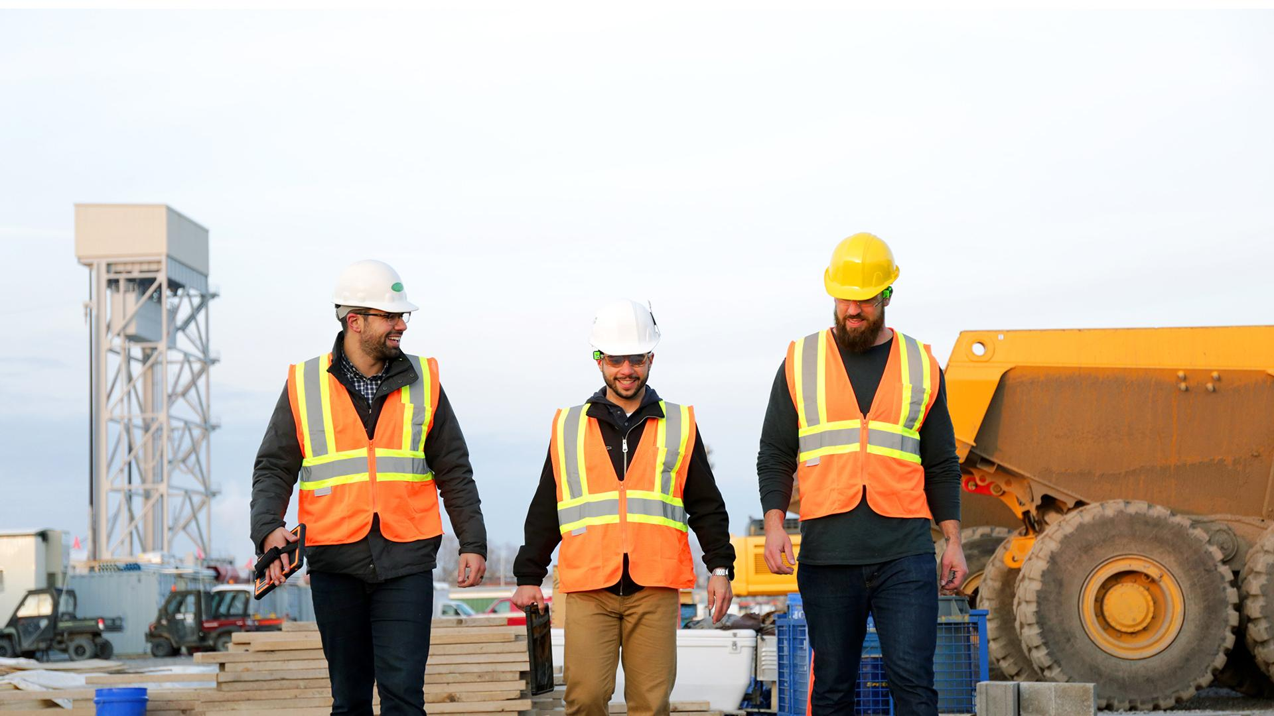

INNOVATE.

